Slide 1

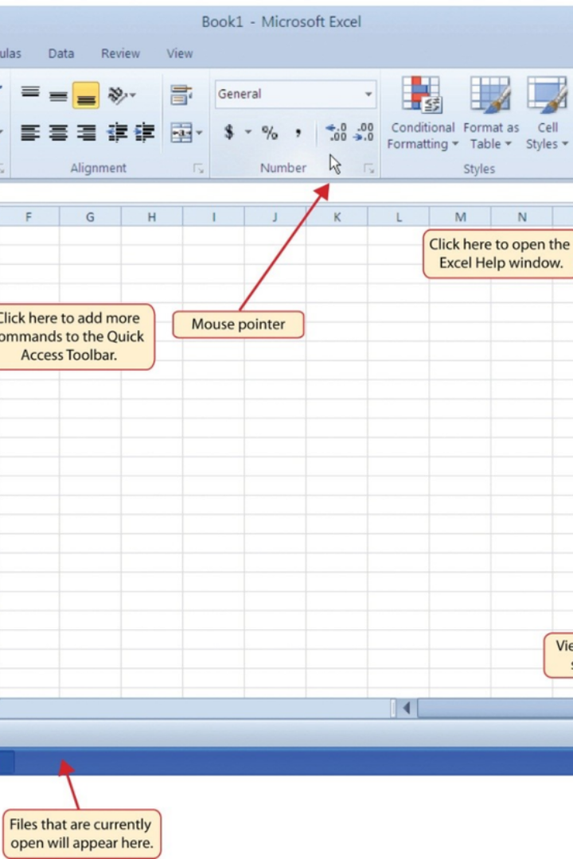


Introduction to Excel Spreadsheet
Excel is a powerful spreadsheet program used for storing, organizing, and manipulating data. It offers a wide range of features for data analysis and visualization.
by Cavidan Vəlizadə

Slide 2
Basic Functions and Formulas
Formulas
Functions
Learn to use basic formulas like SUM, AVERAGE, and more to perform calculations on your data.
Understand essential functions like IF, VLOOKUP, and INDEX/MATCH to manipulate data effectively.

Slide 3
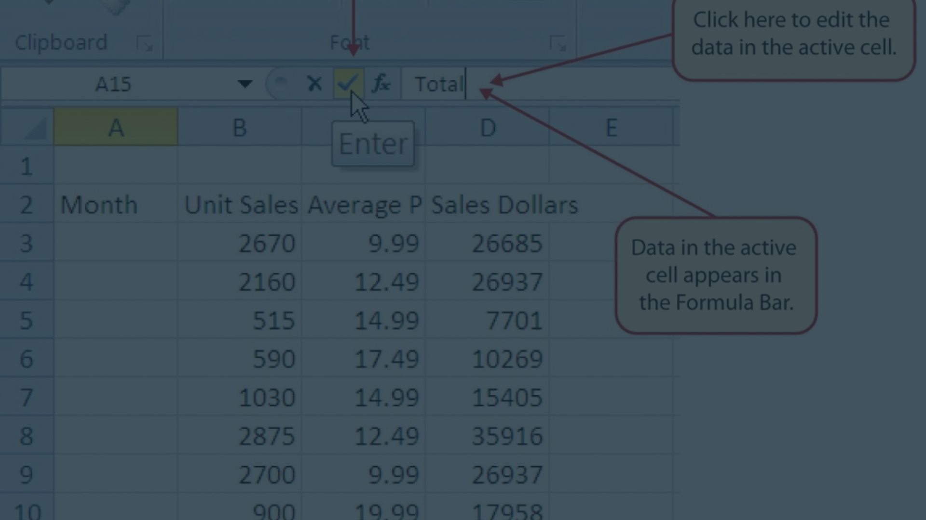
Data Entry and Formatting
Efficient Data Entry
Formatting Techniques
Learn to enter data accurately and efficiently using shortcuts and data validation techniques.
Explore formatting options to make your data visually appealing and easy to interpret.

Slide 4
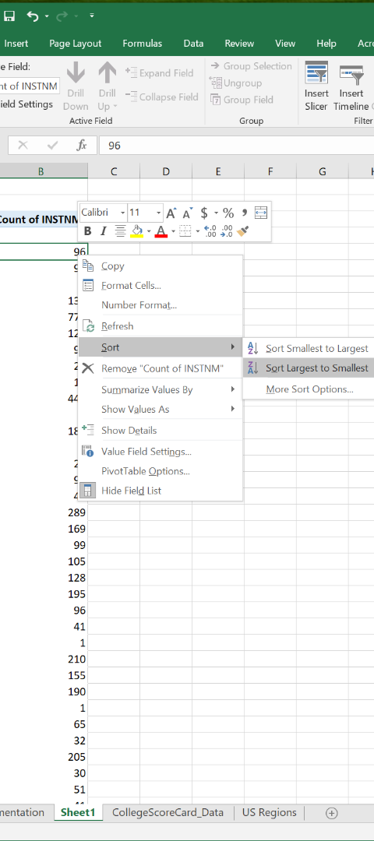


Sorting and Filtering Data
Sorting
Organize data in ascending or descending order to identify trends and patterns easily.
Filtering
Use filters to display only the data that meets specific criteria for better analysis.

Slide 5
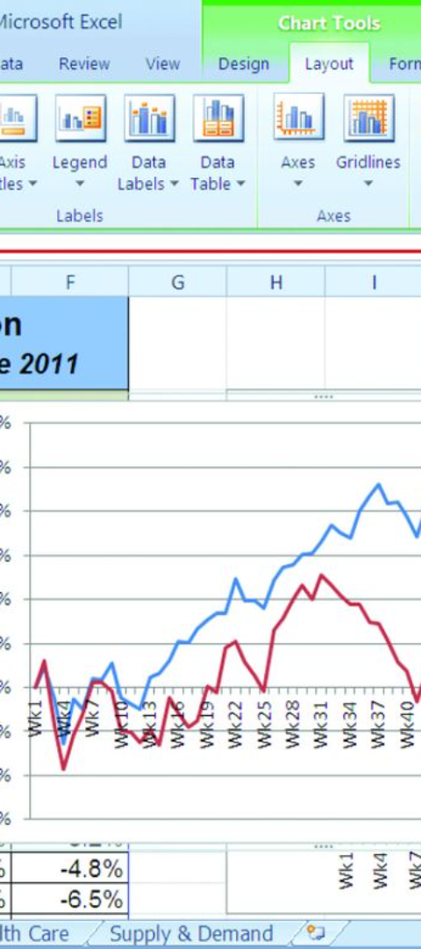
Creating Charts and Graphs
1
Data Visualization
2
Chart Customization
Transform your data into visual representations like bar graphs, pie charts, and more.
Customize the appearance and layout of your charts to effectively communicate your insights.

Slide 6
Conditional Formatting
1000
500K
Visual Alerts
Data Visualization
Highlight important trends or outliers in your data using color scales and icon sets.
Easily identify key data points by applying conditional formatting based on specific criteria.

Slide 7
Pivot Tables and Data Analysis
Summarize Data
Consolidate and analyze large datasets efficiently using pivot tables.
Dynamic Analysis
Quickly change the view and arrangement of data to gain different insights.

Slide 8
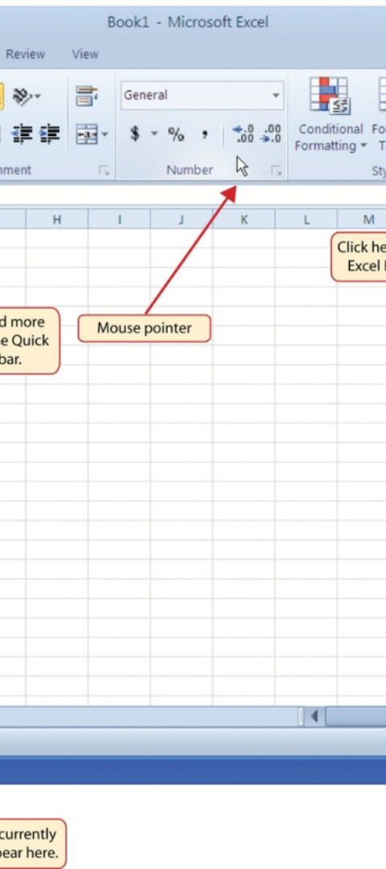
Advanced Features and Tips
1
Macros and Automation
Automate tasks and processes in Excel using macros to save time and reduce errors.
2
Advanced Formulas
Explore complex and powerful functions like array formulas to handle sophisticated calculations.
3
Data Analysis Tools
Utilize statistical, financial, and engineering functions for advanced analysis and modeling.

